Slide 1

Product Define & Discover

Slide 2
Session Flow (Directional)
Modernizing How We Work (15 mins)
Activity Deep Dives
Customer Interview (5 + 10 Activity)
User Persona (5 + 10 Activity)
Break
Opportunity Canvas (10 + 15 Activity)
Story Mapping (10 + 15)
Prototypes + End (10 Mins)
Notes:
Today’s session will include ~3:45 minutes of content – give or take 15 minutes.
Let’s do intro’s – please provide your name, current title, and reason you’re here today.
<I try to document any specific topics that folks want to cover that aren’t part of the core workshop activities>
<I also create a flip-chart that shows each of the activity deep dives as check boxes so that we check them off as we go – helps them understand where they are in the flow of the workshop and what topics are yet to come.>

Slide 3
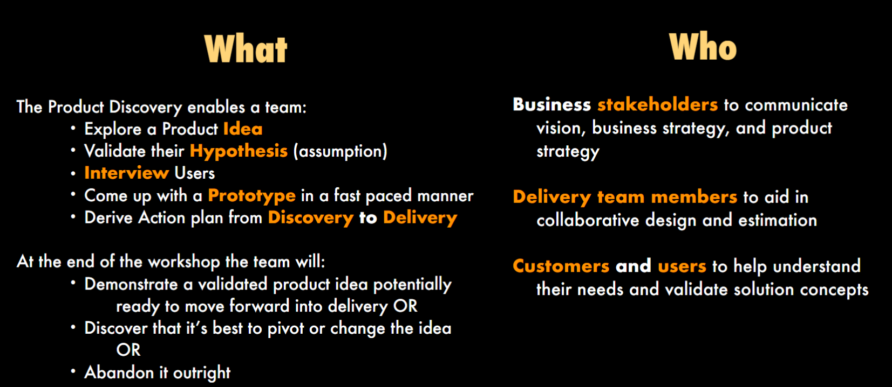
Product Discovery

Slide 4
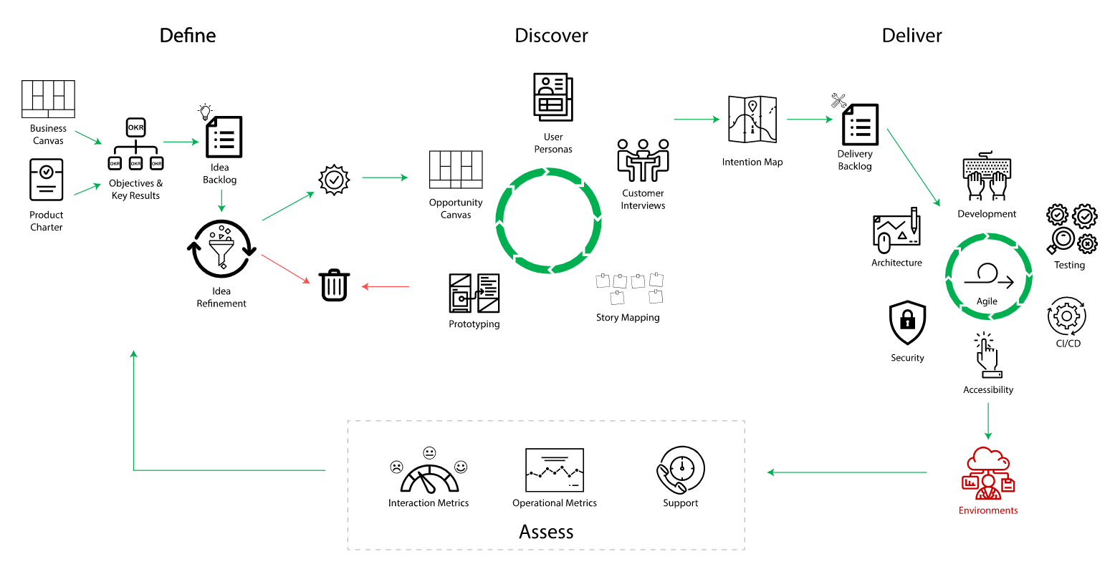
Modernizing How We Work
Notes:
How many of you have leveraged the Playbook so far?
Click into the playbook and show them the basics of how an icon drills into a particular topic just so they understand how it works.
Define:
In short, Product Definition hasn’t changed much over the past 20 years of application development. It’s all about getting clear on why we’re here, who we serve, how we measure success, and our initial swack at ideas to accomplish our goals. We get clear on the assumptions we’re making and articulate what we’re going to need to learn.
The list of ideas we start with is just a set of guesses. A key tenant of Product is that we assume that we’re wrong until we prove ourselves right. Not the other way around.
That’s a big culture shift for most teams, but it’s a powerful one.
Discovery
If we believe that our ideas (aka guesses) are wrong until we prove otherwise, we need to establish an approach to (very quickly) test them. That’s what Product Discovery is all about. We take each significant idea and run it thru a consistent set of filters with all three product roles (Biz,Tech,UX/CX) in order to get a holistic view of an idea and decide together about whether or not we kill the concept or take it forward to delivery. During Discovery, we expose our end-users / customers directly to our ideas and we learn outside of the code – often without building a thing. If you’re a recovering Project Manager, Discovery can be thought of as de-risking our ideas.
Our former culture would have assumed that our big ideas are correct and that we should go straight to building. Building without discovery is THE most expensive (and the slowest) way we can learn. Low fidelity prototyping is both fast and cheap.
SIDE NOTES:
Skip the Question Backlog – it’s duplicative with the Idea Backlog.
Talk about Discovery Prioritization instead of Idea Refinement – better articulates what we’re doing and simplifies the image.
Roadmap content is not currently in the Playbook – it will be added soon and we’ll discuss today
Delivery
We won’t be talking about the mechanics of Scrum or the DevOps technical best practices that are called out within the Deliver section of the Playbook. If you have interest in these topics, dive on into the playbook when you’re back in the wild.
Assess
If you established some clear metrics within your Product Objectives and Key Results (aka success measures), you use them to measure whether or not the capabilities you decided to deliver are actually achieving their desired outcomes. No longer will you measure success by tracking the number of stories you complete. Instead, you’ll assess your success based on the business outcomes of the work that you have completed. The goal is to deliver as little as possible in order to achieve your desired outcomes. Regardless of the outcomes of the work you deliver, you can use both the operational and user-centric metrics that you monitor to drive new product ideas and to inform ongoing discovery work.

Slide 5
Product Play Book (Team Activity)
https://pages.git.target.com/coaching/playbooks/product-playbook/
Notes:
In 2 Separate Breakout Rooms (One for Define and one for Discover) let people go through the Product play book, click each topic and try to understand it.

Slide 6
Customer Interviewing
Exercise: Make a group of 3 (1 Customer, 1 Interviewer and 1 Observer) Question: “Tell me about a product.”
3 minutes apiece (Customer, Interviewer and Observer can shift)
Group Discussion: Let’s Look for Some Themes
Notes:
Let you workshop participants pair up and talk about their most memorable meal.
First person takes 3 minutes, then they switch and 2nd person goes for 3 minutes (take turns interviewing each other)

Slide 7
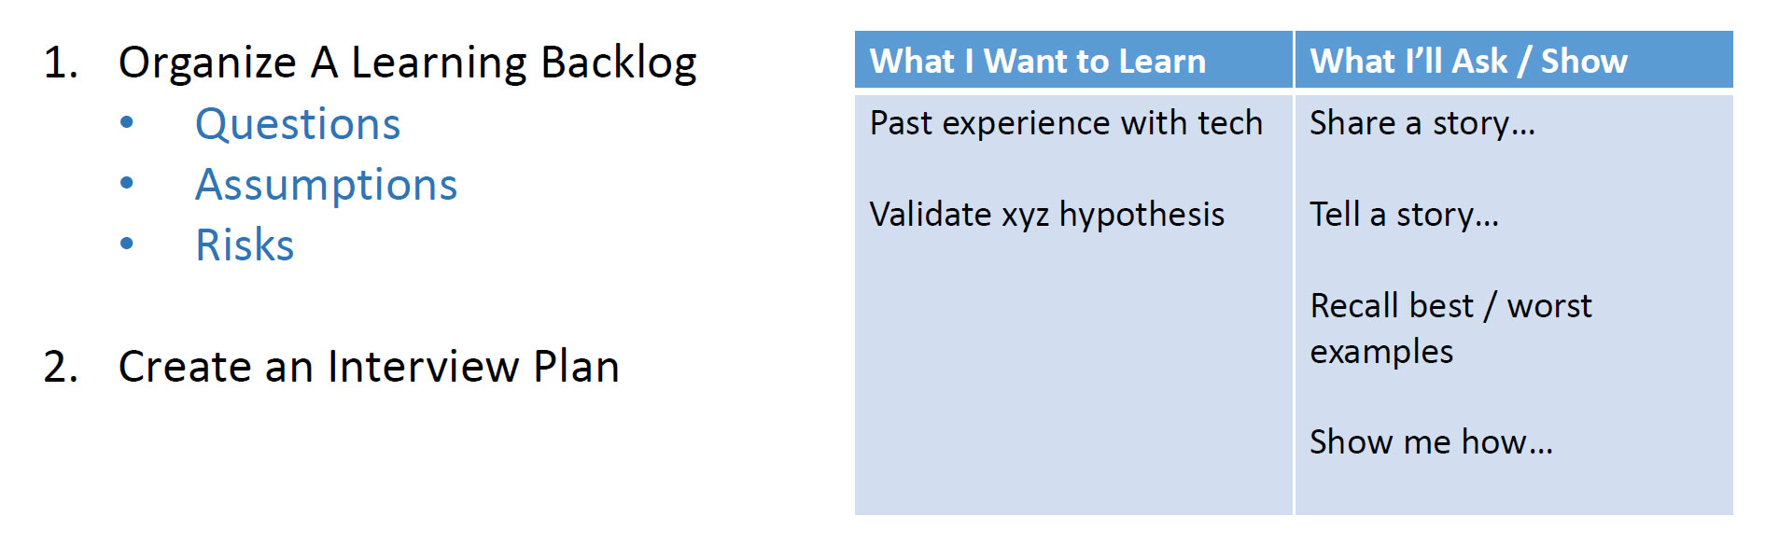
Prep for an Interview Specific to Your Product
Notes:
10 minute exercise – prep for an interview that you’ll conduct when you get back to the wild.

Slide 8
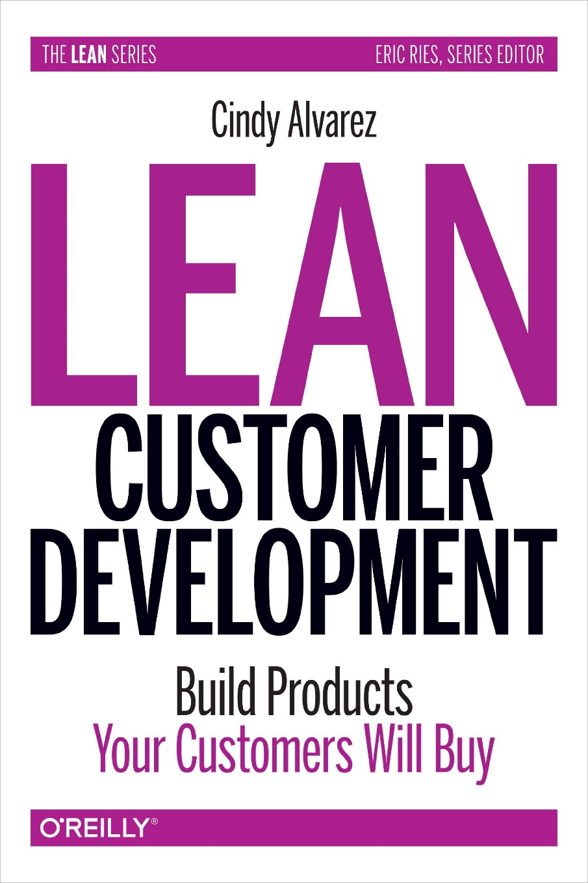
Customer Interviewing Tips
Ultimate Goal = Test our Hypotheses and Challenge Our Assumptions
Generally speaking, have one individual leading the discussion
Others can pitch in as necessary to help get to the goals you established for the session.
Have a dedicated note-taker
Capture exact quotes as often as you can.
Comfort matters for your interviewee – remove physical obstacles
Problem
Validation
Solution
Validation
Early Discovery
Late Discovery
Notes:
This slide is critical for you to understand.
Interviewing is NOT showing something you built for them and asking them if they like it.
You need to start by focusing on nothing but your user and ensuring that you understand the problem space. You need to validate whether or not the problem you are trying to solve is actually important enough to invest in.
Once you have done so, you can slowly start to introduce potential solutions to the problem.
For today’s purposes:
Assume that the Product Venn will interview an individual customer
Focus groups have value, but they tend to create group think. During Discovery, we want you to interview individuals, not groups.
The book image is a link to the Interviewing Primer with tactical content from Cindy Alvarez. Switch over to that deck and review its contents.

Slide 9
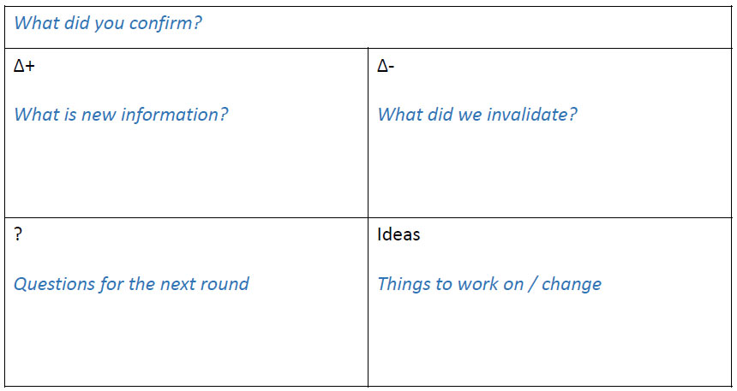
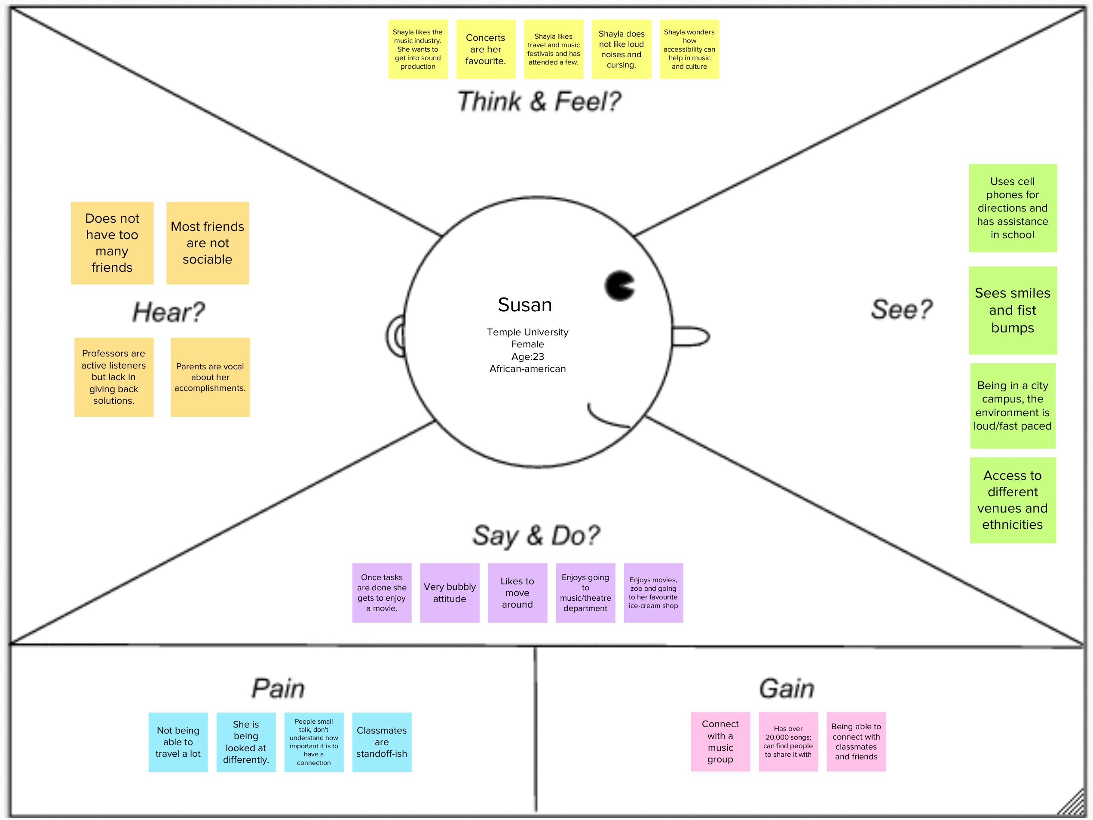
Capturing Interviewing Feedback
2x2 –or- Delta/Next
Empathy Map
Notes:
There are multiple ways to capture the findings you get from your interviews.
The slightly misnamed 2x2 is the most common form you’ll use for 1-on-1 interviews. The template is easy to create and, if you use large flipchart paper, you’ll be able to use sticky notes to document your findings (and either post the whole flipchart or take a photo of it and print it out on 8.5 x 11 paper with the others)
Summarize your interview learnings as soon as possible after the interview.
Leave space between each of your interviews so that you can debrief as a team
The Empathy Map is awesome when you are observing someone use your product within their own working environment (highly recommended best practice) – it enables you to capture the context of their situation so that you aren’t making the mistake of gathering feedback about your product in a vacuum.

Slide 10
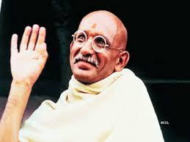
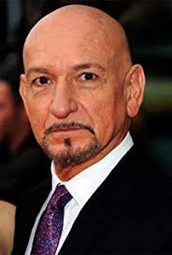
Personas
Vs

Slide 11


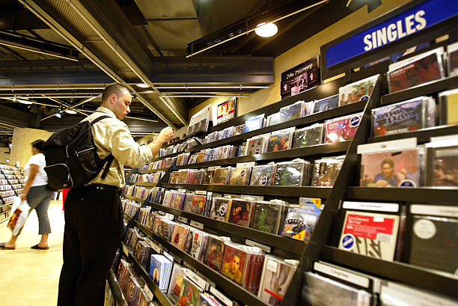
Personas – Who? Why? What?

Slide 12
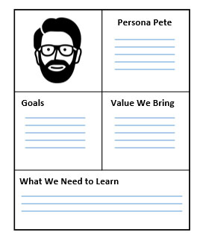

Personas
Logically Related to Charter, Used Throughout Definition & Delivery
Get Ready – you need to be speedy….
Representation of the goals and behavior of a hypothesized group of users.
Keeps your Customer Front-and-Center
Enables the Team to Empathize with the Customer
Enables Prioritization based on Audience
Helps You Understand What you DON’T Know about your Customers
Is NOT a One-and-Done Activity.
Persona Exercise for Your Top Customer
Context – Who is this person?
Goals / Problems – What is this person trying to accomplish?
Value We Bring – How do we help this person accomplish his goals or solve his problems
What Else Do We Need to Learn about this Person?
Notes:
How many of you have done personas for your product? (75% of hands will go up)
How many of you use your personas from day-to-day? (~1 hand will go up)
Personas, when done well, are tools that can truly drive value for the entire life cycle of a product – they allow you to represent a group of users as an individual that you can have empathy for.
There are several structures you can use to generate personas – the key thing to remember is that they are all about enabling your entire team to gain empathy for your customers. The format that we’ll use today will have 5 sections:
Image – after you complete the other four sections, either draw or go nab a stock image that you feel best personifies your user
Name/Context – who is this person? What type of a person are they? What is the context for why these folks use your product?
Goals/Problems – what are they trying to accomplish with your product?
Value We Bring – how are proposing to help them accomplish those goals/fix those problems?
What We Need to Learn – what do we need to validate with them? What else do we need to learn about them?
That last section is where much of the value of the persona comes from – if you have a hearty group of items to validate with your users, you have ammo to create a learning plan that can be incorporated into customer interviews and product discovery work.
Take 10 minutes and create a persona of your most important customer.
When the 10 minutes is up, talk thru the following observations:
What was easy?
What was difficult?
How confident are you with the contents you created?
How will you increase your confidence (validate/turn assumptions into facts, etc.)
How can you ensure that this persona doesn’t get added to SharePoint and starts collecting virtual dust?

Slide 13
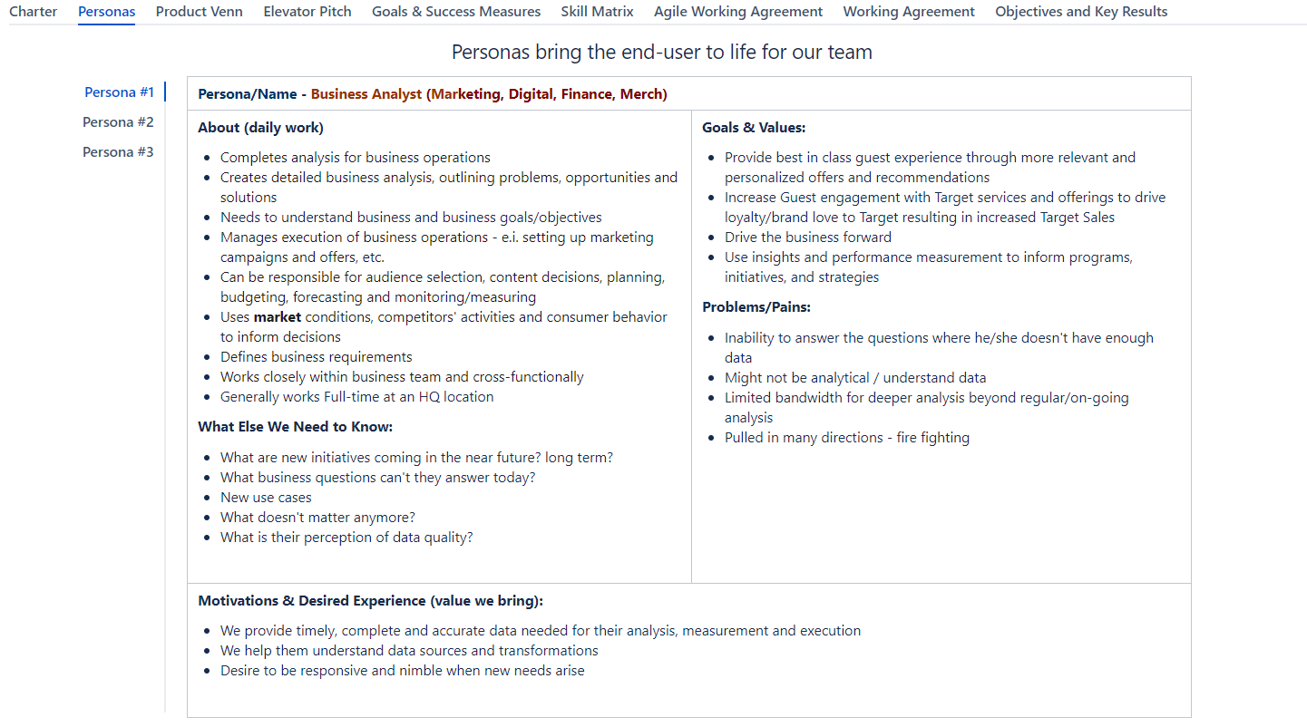

Slide 14
Personas: Your Thoughts
Paraphrased from YOUR words.
Notes:
The Benefits of Personas
Personas are a great way of ensuring a company-wide consensus on precisely who the organization is trying to reach.
Personas help stakeholders stop focusing on their perspective, and start considering the customer's point of view.
Personas introduce the customer's needs into the decision making process.
Personas promote a deeper understanding of the customer.
Personas encourage empathy with the customer.
Personas prevent the customer from being forgotten in the weeds of a project.
https://boagworld.com/usability/personas/

Slide 15
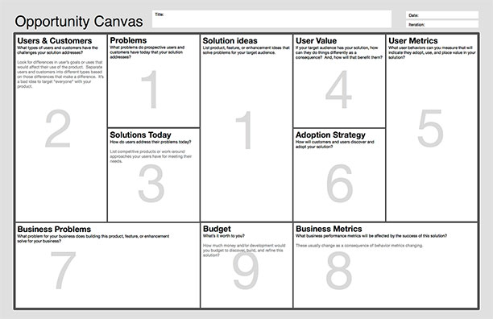
One Approach for Quick, Holistic, Assessment
Why do it?
In short, leveraging the opportunity canvas supports several key activities for your product:
• Establishes a standard evaluation process for comparing the value of ideas
• Enables the team to constrain the design to a finite, and clear, scope
• Collects all relevant concerns for a given opportunity in a consumable format
• Builds shared understanding for the entire team that is working on the opportunity
• Takes a holistic view including success measurement and adoption strategies
As with other canvases (Lean, Business, etc.), the Opportunity Canvas is all about driving a conversation – it is not a form to be filled out or a box to be checked during the Discovery process. Using this type of tool builds rhythm and learning muscle for the team by providing consistent topics to discuss and explore together.
Notes:
The Opportunity Canvas is a tool we can use to compare ideas in a consistent fashion.
(Use a plotter-printed version of the Opportunity Canvas to walk folks thru it) – by this time in the afternoon, it helps to get folks out of their chairs – get them up and standing around the Canvas on the Wall if there are less than about 12 folks in the workshop.
Ask for a real product feature or group of features that one of your participants is exploring for their product.
The owner of the idea that you select will onboard the rest of the group into their team by providing:
A quick description of what their product does and who it serves
A quick description of the specific feature(s) we’ll be exploring together as a group
Facilitator will then begin filling the canvas using sticky notes (using information from the collective group – get everyone involved with coming up with ideas – we don’t want this to be 11 people watching and 1 person populating)
Name
Problem we’re solving
Potential solution ideas to explore
Users / Customers that will leverage the solution
How they solve for this problem today
What is the value of solving for this differently?
How will you measure success for this set of features?
Are there different metrics that you’ll need to capture in order to determine whether or not there is a business case for solving this problem? (answer should be yes) As opposed to User Metrics, these metrics will show the value to Target as a business (larger scale impacts of solving the problem, etc. – need to make sure that the juice is worth the squeeze)

Slide 16
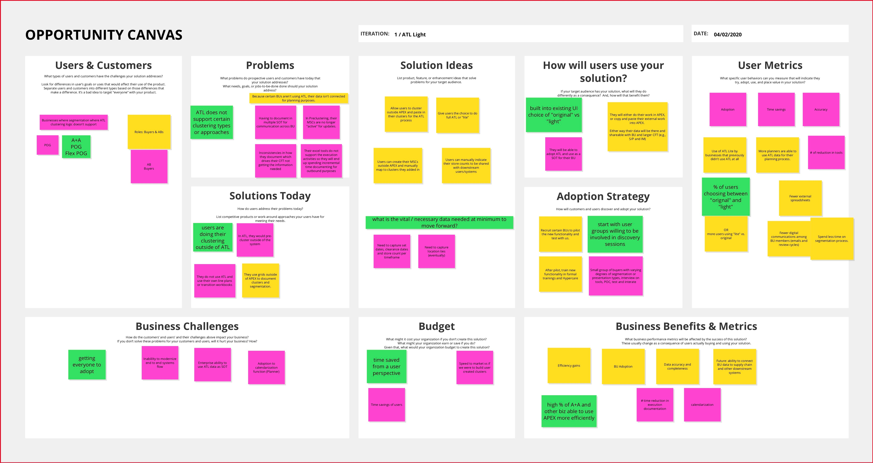

Slide 17
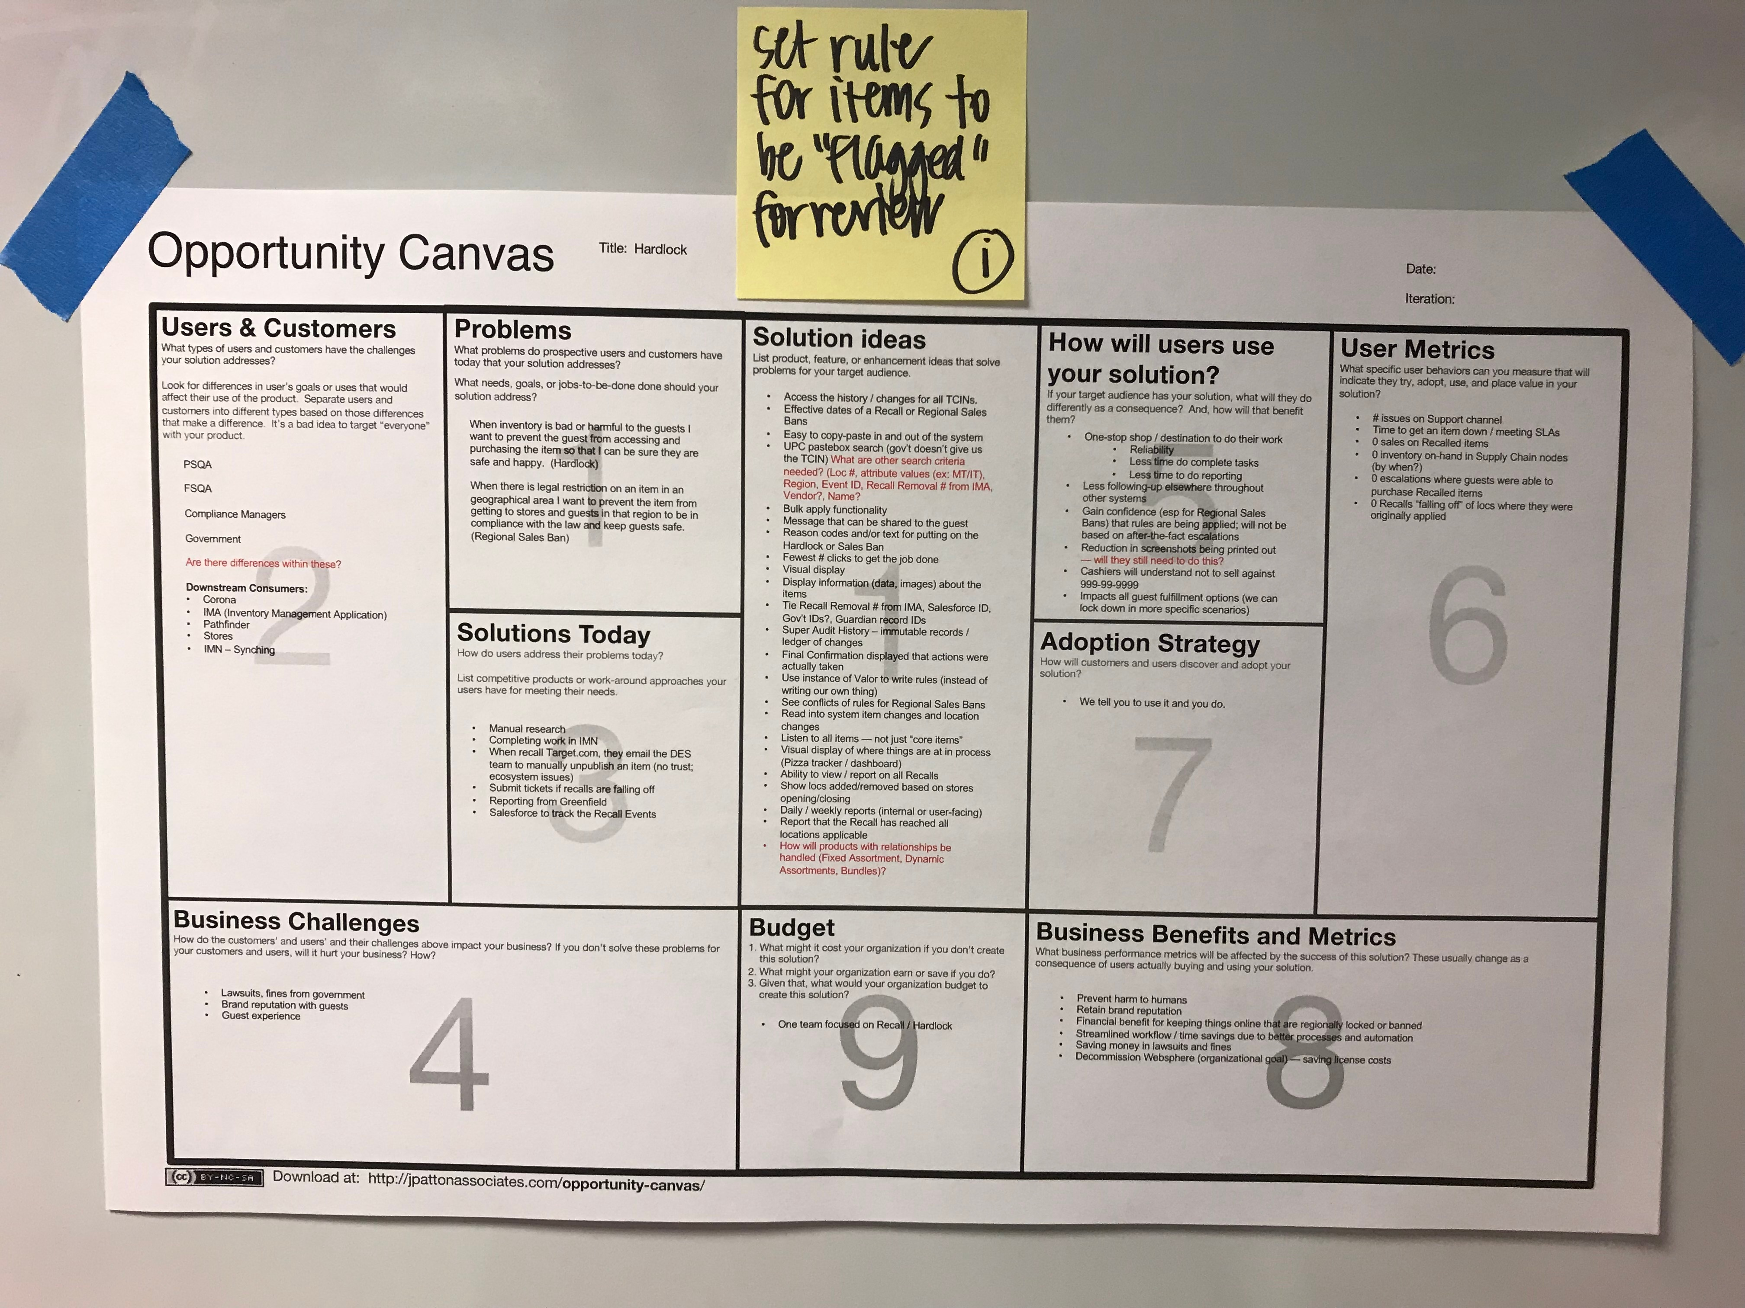

Slide 18
Opportunity Canvas (cont)
Exercise:
Let’s Do One Together
Volunteer:
Business Person – Let’s Talk About A Recent Functional Request
Notes:
See previous slide notes

Slide 19
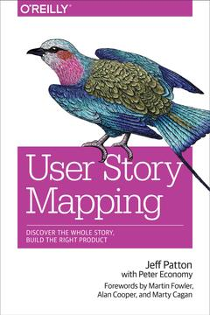
Story Mapping
“Story mapping keeps us focused on users and their experience, and the result is a better conversation, and ultimately a better product.” – Jeff Patton
Notes:
Story Mapping Exercise – everyone has 3 minutes to capture the steps they completed as they got ready for work. From the time they woke up, to the time they arrived at work this morning.
Take 3 volunteers to share their stickies 1 at a time.
Each person will…
Place a sticky on the wall
Describe the contents of the sticky (telling the story of their morning as they go)
Place the next sticky on the wall
Describe the contents… etc.
Be sure to leave some room between the stickies from side to side
Look for patterns in the stickies and let the group know that most large scale processes can be summarized in 5-8 sets of grouped activities.
Take 2 volunteers to silently group the stickies into 5-8 categories and to label them accordingly (use a big sticky note and group the smaller ones beneath each appropriately) - they’ll need to dedupe as they go.
Take 3 new volunteers to tackle a new challenge (don’t tell them the surprise until they have volunteered)
New Challenge = update your flow to reflect having only 5 minutes to get out the door. Keep required tasks above the line, move no-longer-required tasks beneath the line. Document any new activities that may be required using square sticky notes and markers.
Exercise take-aways – you have, essentially, just prioritized an MVP for getting out the door in the morning. It’s a process that is much like the work you’ll do when defining the portion of a product that you’ll deliver first. Let’s take a look at the Sitter Sync example we looked at earlier.

Slide 20
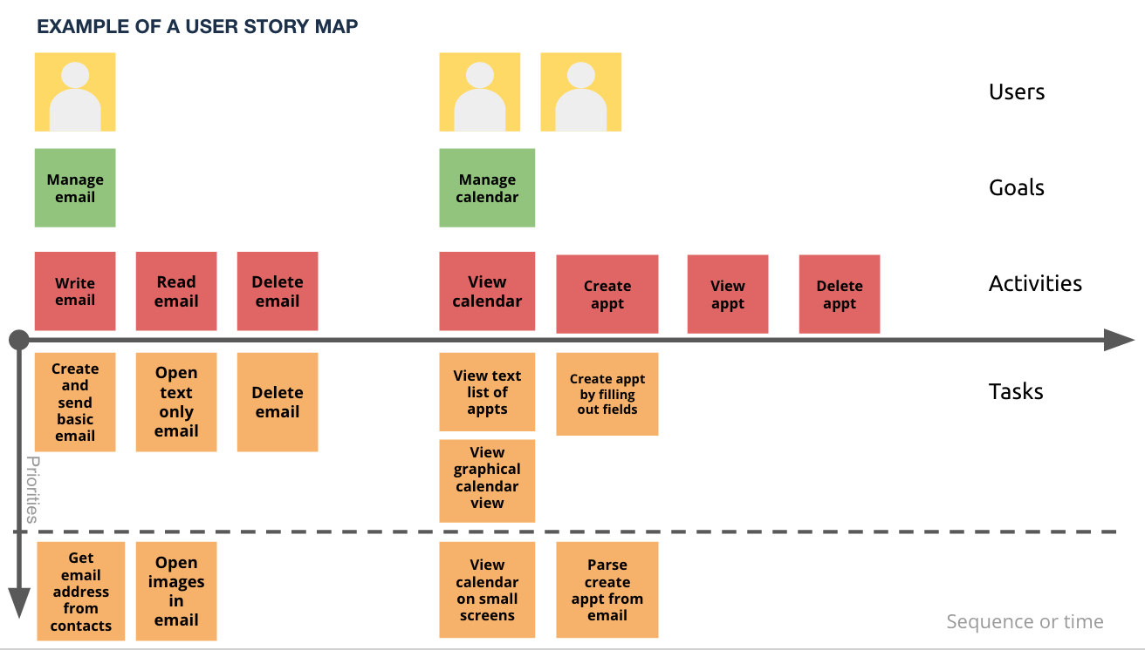
Story Mapping
Notes:
Here is the starting point that we established for our new product.
We assumed that Mary the Mom would like to have a profile that houses some basics about her fam, herself, reusable communication info, etc.
We assumed that she would also need to manage some “routines” specific to the kiddos – Bed Times, Dinner guidelines, Entertainment Considerations, etc.
For the evening that Mary will be gone, we assumed that she’d want to capture some details about where she’ll be.
We know that the sitter will need to have access to the info
And we think that they’ll need to leverage the tool to support easy communication

Slide 21
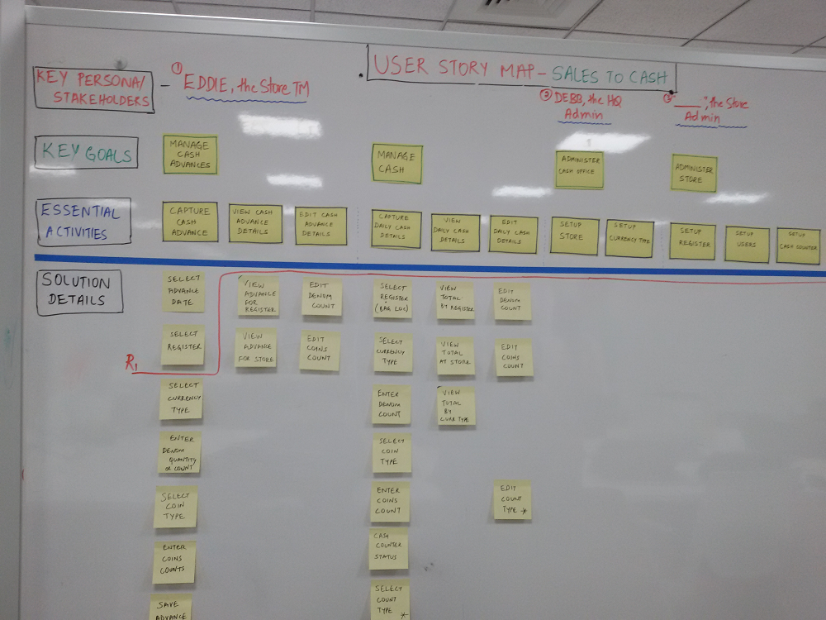
Story Mapping
Notes:
Our product is new to the market and we don’t even know if it’s valuable enough to move forward with.
So we make sure we build as little as possible until we can prove out the value proposition.
1st Journey = low-tech validation of purpose of the product with Mary
2nd Journey = thin slice of capability across the entire flow to validate tech stack and pull Stacie into the mix
3rd Journey = communication capabilities

Slide 22
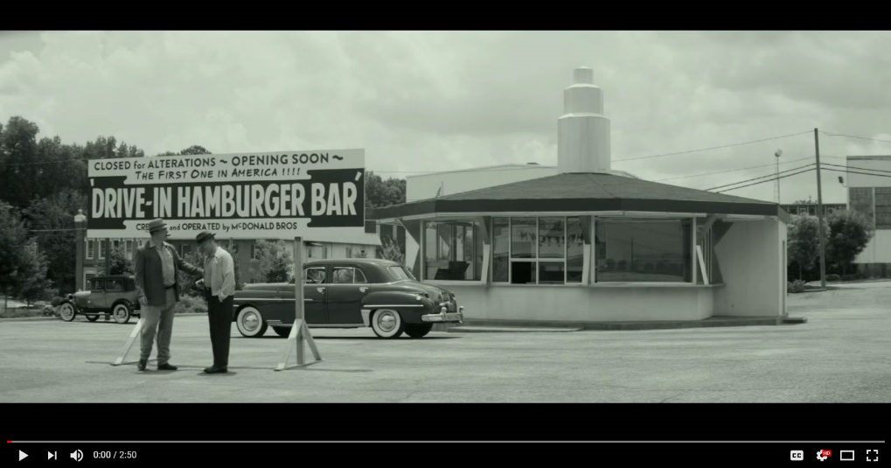
Prototyping
Start with a Narrative
Choose a task or set of tasks your user wishes to perform.
Write a description of the things the user does to reach their goal – it’s a prose version of how the user will interact with your product.
Identify UI Ingredients & Tools
Start with your narrative – where the narrative calls for the user to view something on the screen, note down on paper or a post-it the information your UI will need to have.
Draw, cut out, and organize ingredients and tools on paper
By placing the components on paper
Notes:
The concepts apply to tech and non-tech alike.
Watch the clip from “The Founder” to see an example of a real-life process flow / physical environment test from McDonald’s
How can you apply these concepts to your own Product in ways that you don’t today?

Slide 23
Call to Action
Activity | Description
Embrace the Mindset | Roadmaps Are NOT Innately Evil – They Are Part of a Larger Context
Establish a Product Outlook | Include 3 Components Vision (Why Are You Here, What Are Your OKRs?) Learning Priorities (Bets) Delivery Roadmap (Commitments)
Share Your Work with Your Leader | Start With Your Team, Graduate to Group/Portfolio
TREAT YOUR OUTLOOK LIKE A PRODUCT
Who is the Customer? What Comm Problems Are You Solving For?
Notes:
Idea to Embrace
Roadmaps Are NOT Innately Evil – They Are Part of a Larger Context
Consider Establishing a Product Outlook Including 3 Components:
Vision (Why Are You Here, What Are Your OKRs?)
Learning Priorities (Bets)
Delivery Roadmap (Commitments)
Treat Your Outlook Like a Product
Who is the Customer? What Problems Do They Solve?
Share Your Work (And the Why) With Your Leader

Slide 24
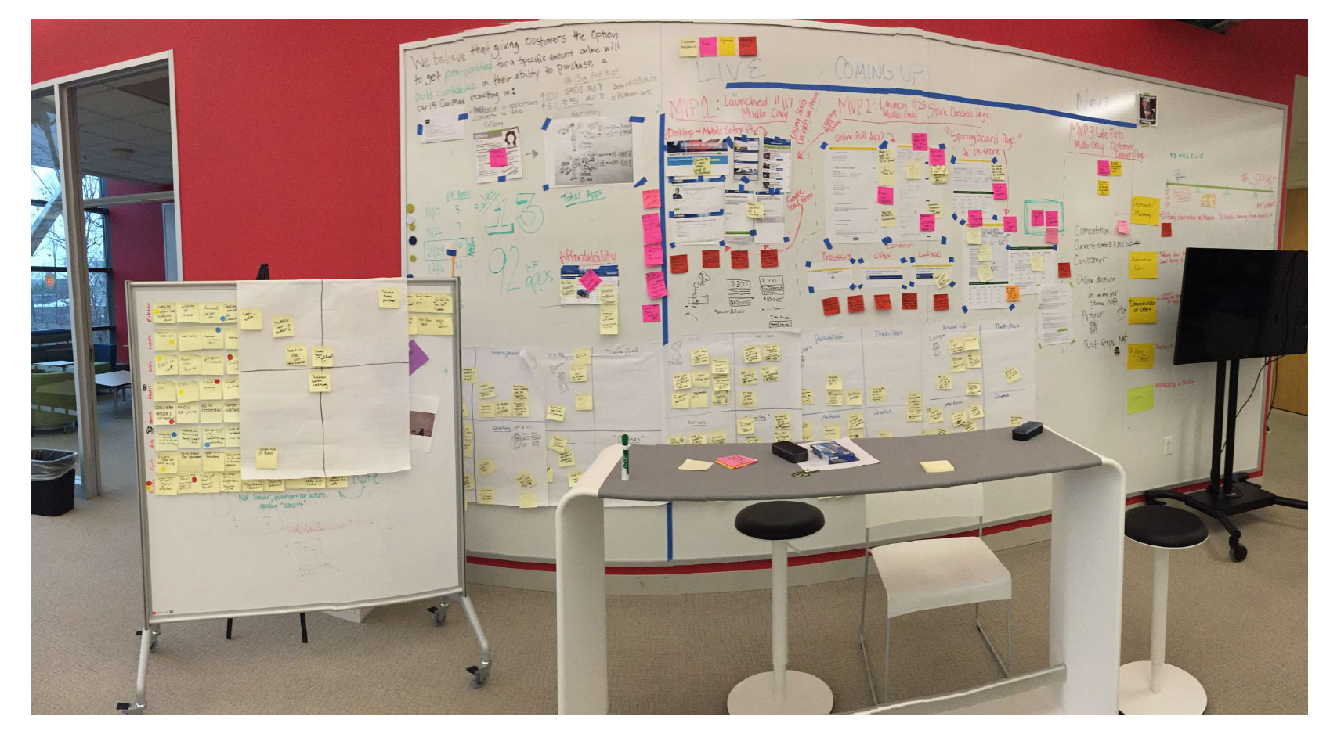
How Do We Use this Define & Discover Stuff?
Notes:
Before we dive into the meat of the activities, let’s fast-forward to the end of our time together – how are you going to leverage this stuff when you head back to your work areas?
Here’s an example from Archie Miller at Carmax – check out his “Crime Board” – essentially, a bunch of clues that help them generate a product that is going to delight their customers.
The upper left = product hypothesis – getting preapproved creates confidence which will ultimately enable higher sales rates.
Just beneath that = personas they’re going after
Beneath that = metrics they are using to measure success
Rolling Whiteboard = story maps that their customers helped generate specific to getting financing for a car
The 2x2 flipcharts = outcomes of specific customer interviews
Most of the Big Board = MVP 1, 2, and 3 Definitions and preliminary designs
Not shown = their Story Map for the whole experience
None of these individual components stands on its own – the combination creates a picture that includes all of the levers they are pulling and pushing to react to their ongoing learnings. All of the activities are ongoing and living/breathing.
Common questions/observations =
My team is distributed – how do we do this? Photos, videos, online tools, and face-to-face travel budgets so that the team stays connected.

Slide 25
Product Values
EMPATHY
PASSION
CURIOSITY
HUMULITY
BIAS TOWARD ACTION
HUMOR
TEAM FIRST
FOR OUR
CUSTOMERS
TEAMMATES
STAKEHOLDERS
SHAREHOLDERS
PARTNERS
FOR
OUR PRODUCT
OUR ROLE
OUR DOMAIN
LEARNING
INNOVATION
ABOUT
PRODUCT IDEAS
WHAT’S NEXT
OUR PROFESSION
IMMERSIVE LEARNING
WE
ASSUME WE ARE WRONG UNTIL PROVEN RIGHT
WE
EMPOWER OUR TEAMS
OPERATE WITH URGENCY
DO MORE THAN WE TALK
VALUE OUTCOMES OVER OUTPUT
CHALLENGE EACH OTHER TO GROW
WE
DON’T TAKE OURSELVES TOO SERIOUSLY.
SELL STUFF THAT PEOPLE WANT AND SOMETIMES NEED.
HAVE FUN WORKING TOGETHER.
WE
RECOGNIZE THAT WE ARE PART OF THE LARGER ENTERPRISE.
CANNOT SUCCEED AS STAND-ALONE BUSINESS UNITS.
BUSINESS AND TECH ARE ONE IN THE SAME.
Notes:
Individual performance incentives should be built around theses primary aspects of our culture.
Outcomes > Output
Business + Technology alignment
Investment approach – teams not projects
Innovative vs Tactical
Small empowered teams
Dojo – Embed and learn
Meetups

Slide 26
Product is a Mindset Marked by ~3 Key Themes
Customer is at the Center of All We Do
Product is About Determining What to Build. Our Ideas are Hypotheses.
Focus on Outcomes over Output.
Remember : Not every tool in the playbook is used by every product team in every situation. It’s about Shared Understanding.
Notes:
Reinforce a few key points that we want them to walk away with.
Shared Understanding is a critical point to understand – it’s not about one perspective winning, it’s about all perspectives coming together to establish a new one that everyone shares. Accomplishing Shared Understanding requires deliberate behaviors – and it’s well-worth the effort.

Slide 27
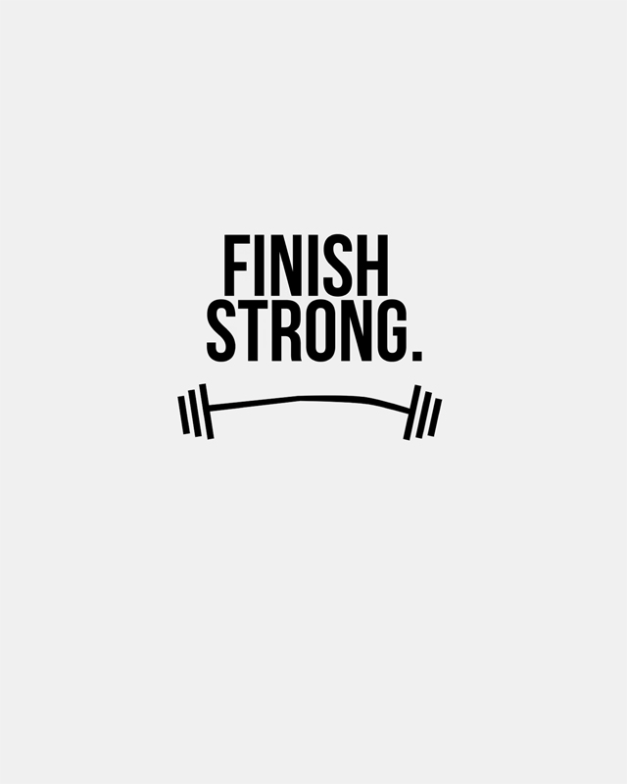
Session Wrap
5 Minutes To Go! Finish Strong
The 3 Things you’ll take back to your team
Any topics that you’ll explore independently over the next month
Session Eval – please complete before you leave. Goal is 100% response rate.
Notes:
Send following link (it is customized for your 10/26 class) https://www.surveygizmo.com/s3/3934113/Product-Playbook-Define-Deliver-Workshop-10-26-17 to each attendee. It consists of 6 questions that should take less than 2 minutes total to complete.
The things they’ll take back to the team and the continual learning topics are just for them. You don’t need to collect them.

Slide 28
Thank you!
Feedback & Closure

